Slide 1
ONLINE CLASS
GRAPH THEORY
BICTE SEMESTER
2078/03/22
PRESENTED BY KALYAN DAHAL

Slide 2
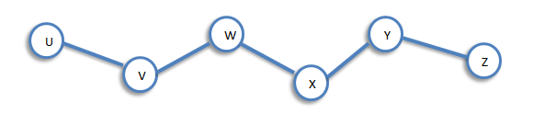
Walk
A walk of length k in a graph G is a succession of k edges of G of the form uv, vw, wx, . . ., yz.
We denote this walk by uvwx …….. yz and refer to it as a walk between u and z.

Slide 3
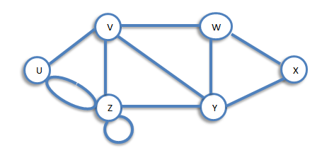
Trail and Path
If all the edges (but not necessarily all the vertices) of a walk are different, then the walk is called a trail. If, in addition, all the vertices are difficult, then the trail is called path.
The walk vzzywxy is a trail since the vertices y and z both occur twice.
The walk vwxyz is a path since the walk has no repeated vertices.

Slide 4
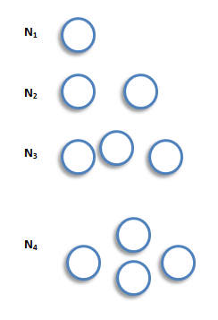
Null Graphs
A null graph is a graph containing no edges. The null graph with n vertices is denoted by N_{n}. The following are the examples of null graphs.
Note that N_{n} is regular of degree 0.

Slide 5
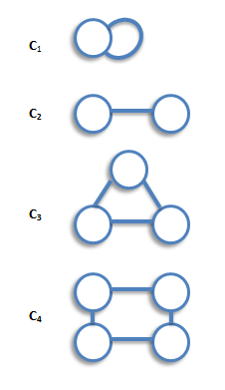
Cycle Graphs
A cycle graph is a graph consisting of a single cycle. The cycle graph with n vertices is denoted by C_{n}. The following are the examples of cyclic graphs.
Note that C_{n} is regular of degree 2, and has n edges.

Slide 6
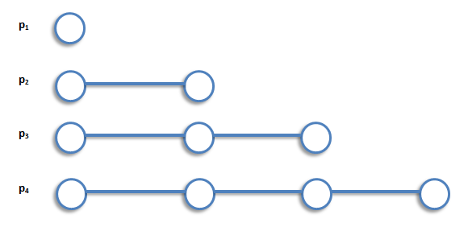
Path Graphs
A path graph is a graph consisting of a single path. The path graph with n vertices is denoted by P_{n}. The following are the examples of path graphs.
Note that path graph, P_{n}, has n-1 edges, and can be obtained from cycle graph, C_{n}, by removing any edge.

Slide 7
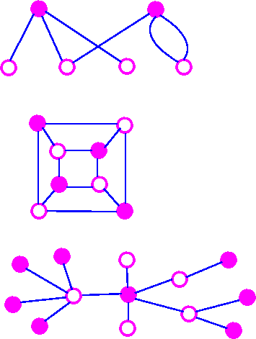
Bipartite Graphs
A bipartite graph is a graph whose vertex-set can be split into two sets in such a way that each edge of the graph joins a vertex in first set to a vertex in second set. The examples of bipartite graphs are:

Slide 8
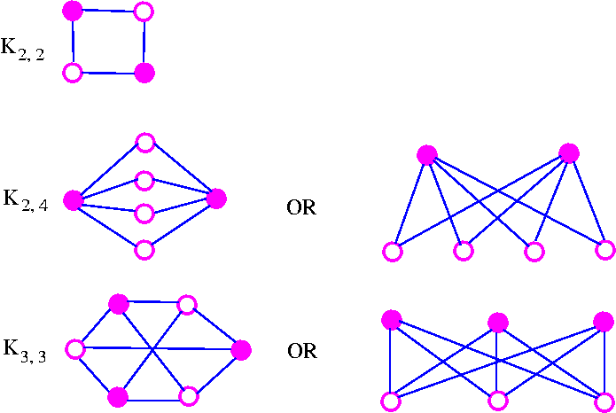
Complete Bipartite Graph
A complete bipartite graph is a bipartite graph in which each vertex in the first set is joined to each vertex in the second set by exactly one edge. The complete bipartite graph with r vertices and 3 vertices is denoted by K_{r,s}. The following are some examples.

Slide 9
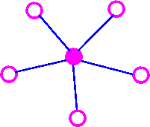
Continued…..
Note that K_{r,s} has r+s vertices (r vertices of degrees, and s vertices of degree r), and rs edges. Note also that K_{r,s} = K_{s,r}.
An Important Note: A complete bipartite graph of the form K_{r,s} is called a star graph.

Slide 10
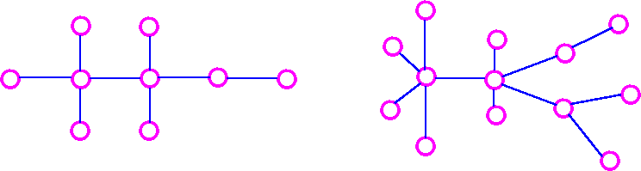
Tree Graph
A tree is a connected graph which has no cycles.

Slide 11
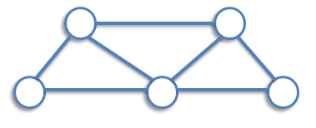
Spanning Tree
If G is a connected graph, the spanning tree in G is a subgraph of G which includes every vertex of G and is also a tree. Consider the following graph.
The following are the three of its spanning trees:

Slide 12
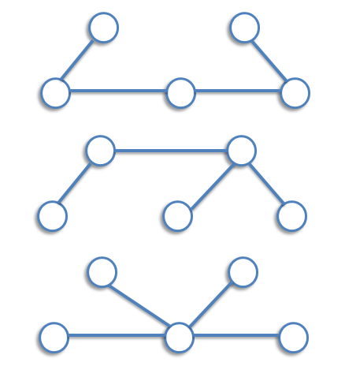
Continued…..

Slide 13
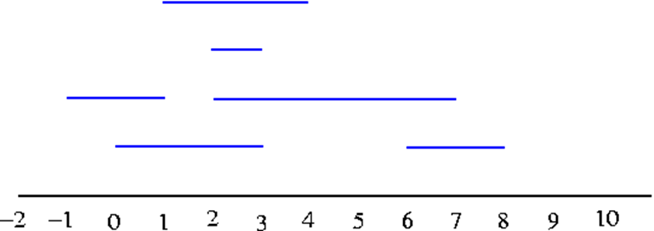
Interval Graphs
Consider the intervals (0, 3), (2, 7), (-1, 1), (2, 3), (1, 4), (6, 8) which may be illustrated as
We can construct the resulting interval graphs by taking the interval as vertices, join two of these vertices by an edge whenever the corresponding intervals have at least one point in common.

Slide 14
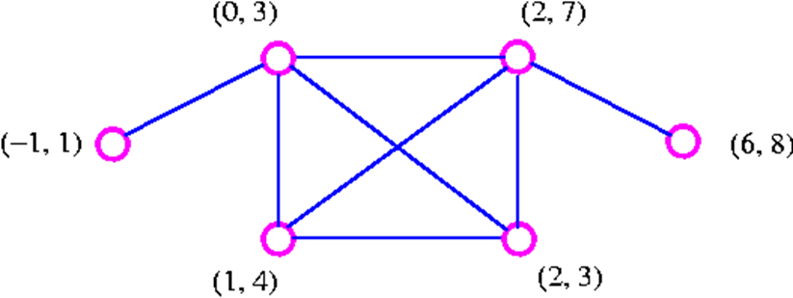
Continued…..
Note that since the intervals (-1, 1) and (1, 4) are open intervals, they do not have a point in common.

Slide 15
Definition of Diagraph
A directed graph or diagraph D consists of a set of elements, called vertices, and a list of ordered pairs of these elements, called arcs. The set of vertices is called arcs. The set of vertices is called the vertex-set of D, denoted by V(D), and the list of arcs is called the arc-list of D, denoted by A(D). If v and w are vertices of D, then an arc of the form vw is said to be directed from v to w, or to join v to w.

Slide 16
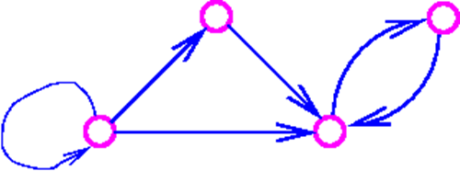
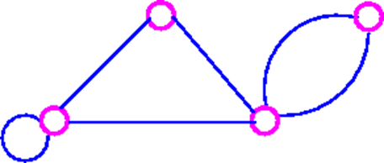
The underlying graph
The underlying graph of diagraph is the graph obtained by replacing each arc of diagraph by corresponding (undirected) edge. For example, consider the following digraph
The underlying graph of the above digraph is

Slide 17
Cube Graph
The cube graphs is a bipartite graphs and have appropriate in the coding theory. The cube graphs constructed by taking as vertices all binary words of a given length and joining two of these vertices if the corresponding binary words differ in just one place. The binary words of length k are called the k-cube (or k-dimensional cube) graph and is denoted by Q_{k}. The following are some examples.

Slide 18
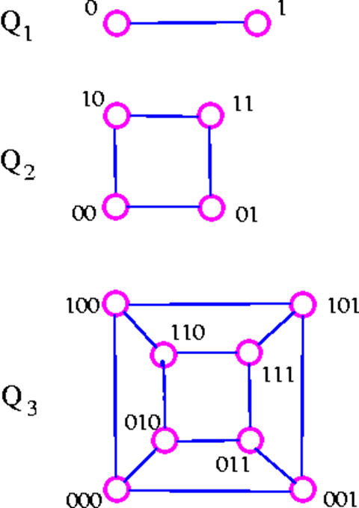
Continued…..
Note that Q_{k} has 2^{k} vertices and is regular of degree k. It follows from consequence 3 of the handshaking lemma that Q_{k} has k* 2^{k-1} edges.

Slide 19
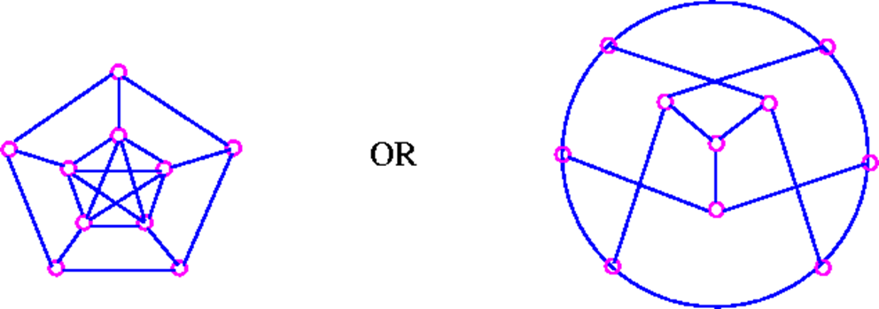
The Peterson Graph
This graph is named after a Danish mathematician, Julius Peterson (1839-1910), who discovered the graph in a paper of 1898.

Slide 20


